Slide 1

Tree Diagrams
EQ: Draw and use a tree diagram to find conditional probabilities.

Slide 2
Quick write
What method did we learn about using to help calculate the sample space yesterday.
Write as much as you can remember about yesterday’s lesson.

Slide 3
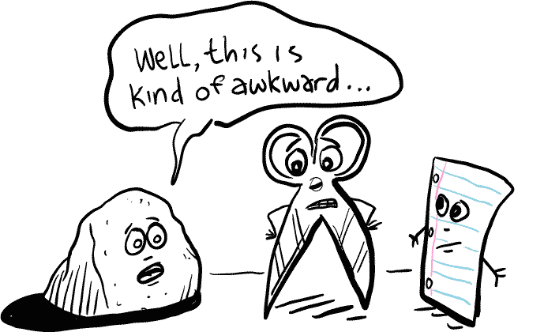
Z

Slide 4
Hook
Rock Paper Scissors Friends.
https://www.youtube.com/watch?v=o_xH__mg03w

Slide 5

Z
Scissors Paper Stone
Create the following table to complete as you play
Play the game 15 times
Add up your tally for the Total
Fill in the 3 probabilities (these are the Total / 15)
Use the calculator these into convert these into decimals.
Result | Tally | Total | Probability
A Wins
B Wins
Draw
Scissors beats paper (cuts it)
Paper beats stone (wraps it)
Stone beats scissors (blunts it)
Showing the same is a draw
Is it a fair game?

Slide 6
Z
Scissors Paper Stone
Can you find a way to calculate the probabilities of the game using a tree diagram?
Scissors
1/3
Paper
1/3
1/3
Stone
Player A

Slide 7
Z
Scissors Paper Stone
AND: x
OR: +
1/3
Scissors
Draw
1/3 x 1/3 =
1/9
AND
Scissors
Paper
A Wins
1/3 x 1/3 =
1/9
1/3
1/3
Stone
B Wins
1/3 x 1/3 =
1/9
1/3
OR
1/3
Scissors
B Wins
1/3 x 1/3 =
1/9
Paper
Paper
Draw
1/3 x 1/3 =
1/9
1/3
1/3
1/3
Stone
A Wins
1/3 x 1/3 =
1/9
1/3
1/3
Scissors
A Wins
1/3 x 1/3 =
1/9
Stone
Paper
B Wins
1/3 x 1/3 =
1/9
1/3
1/3
Stone
Draw
1/3 x 1/3 =
1/9
Player A
Player B
9/9
P(A Wins) =
1/9 + 1/9 + 1/9
P(B Wins) =
1/9 + 1/9 + 1/9
P(Draw) =
1/3
= 1/3
= 3/9
= 3/9
= 1/3

Slide 8
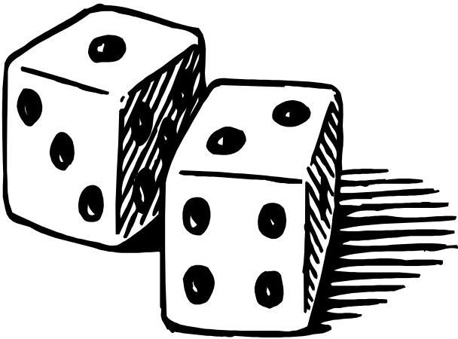
Two Dice

Slide 9
First dice
Second dice
Six
Six
Not six
Six
Not six
Not six

Slide 10


PROBABILITIES
First dice
Second dice
Six
Six
Not six
Six
Not Six
Not six

Slide 11
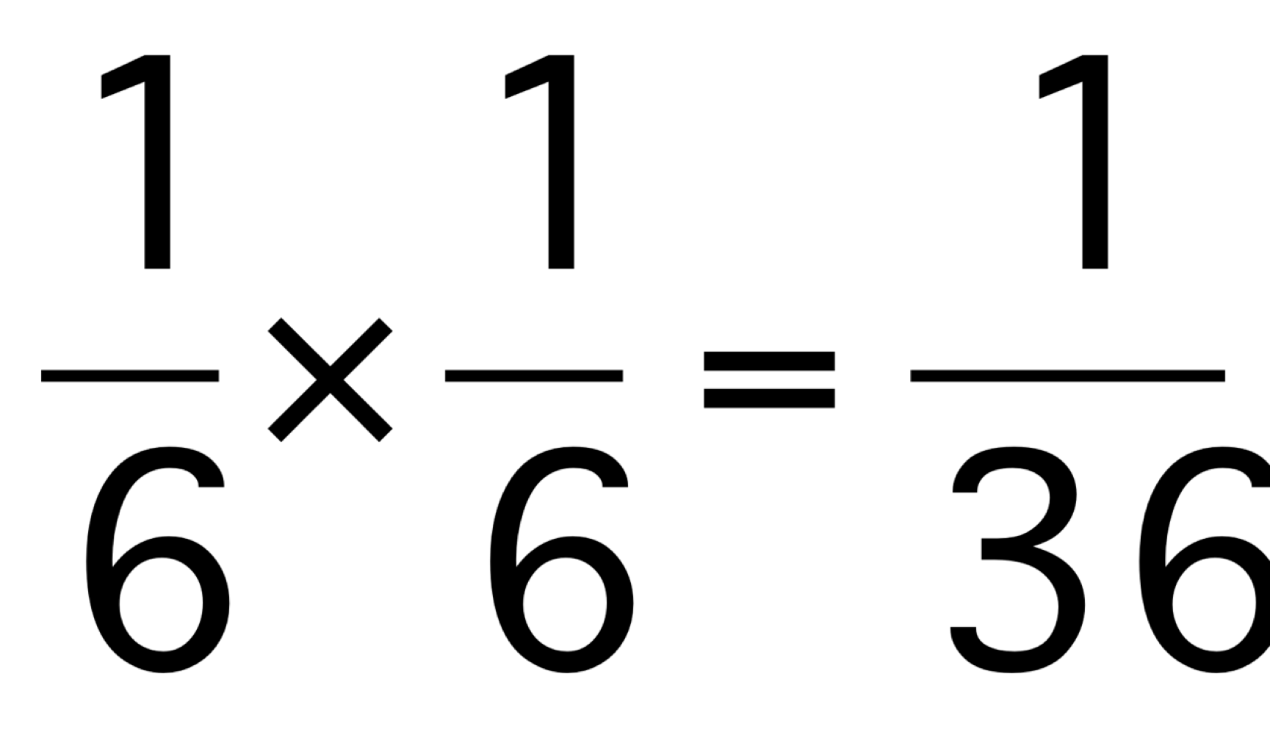
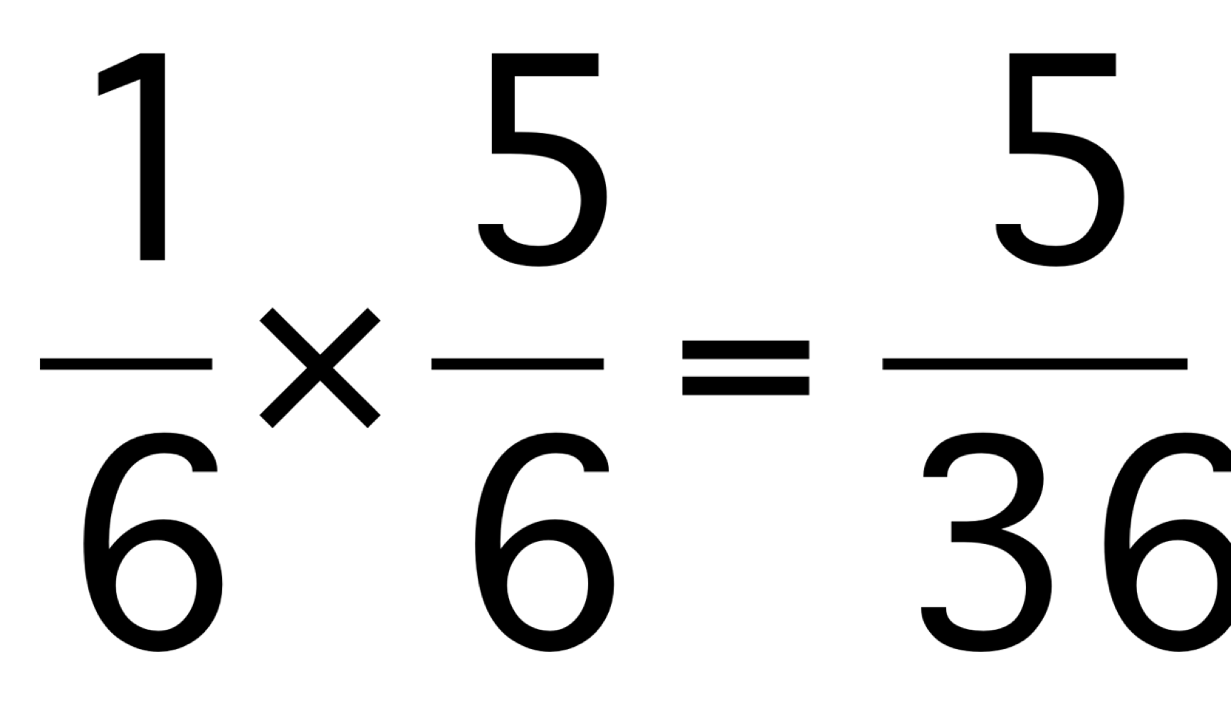
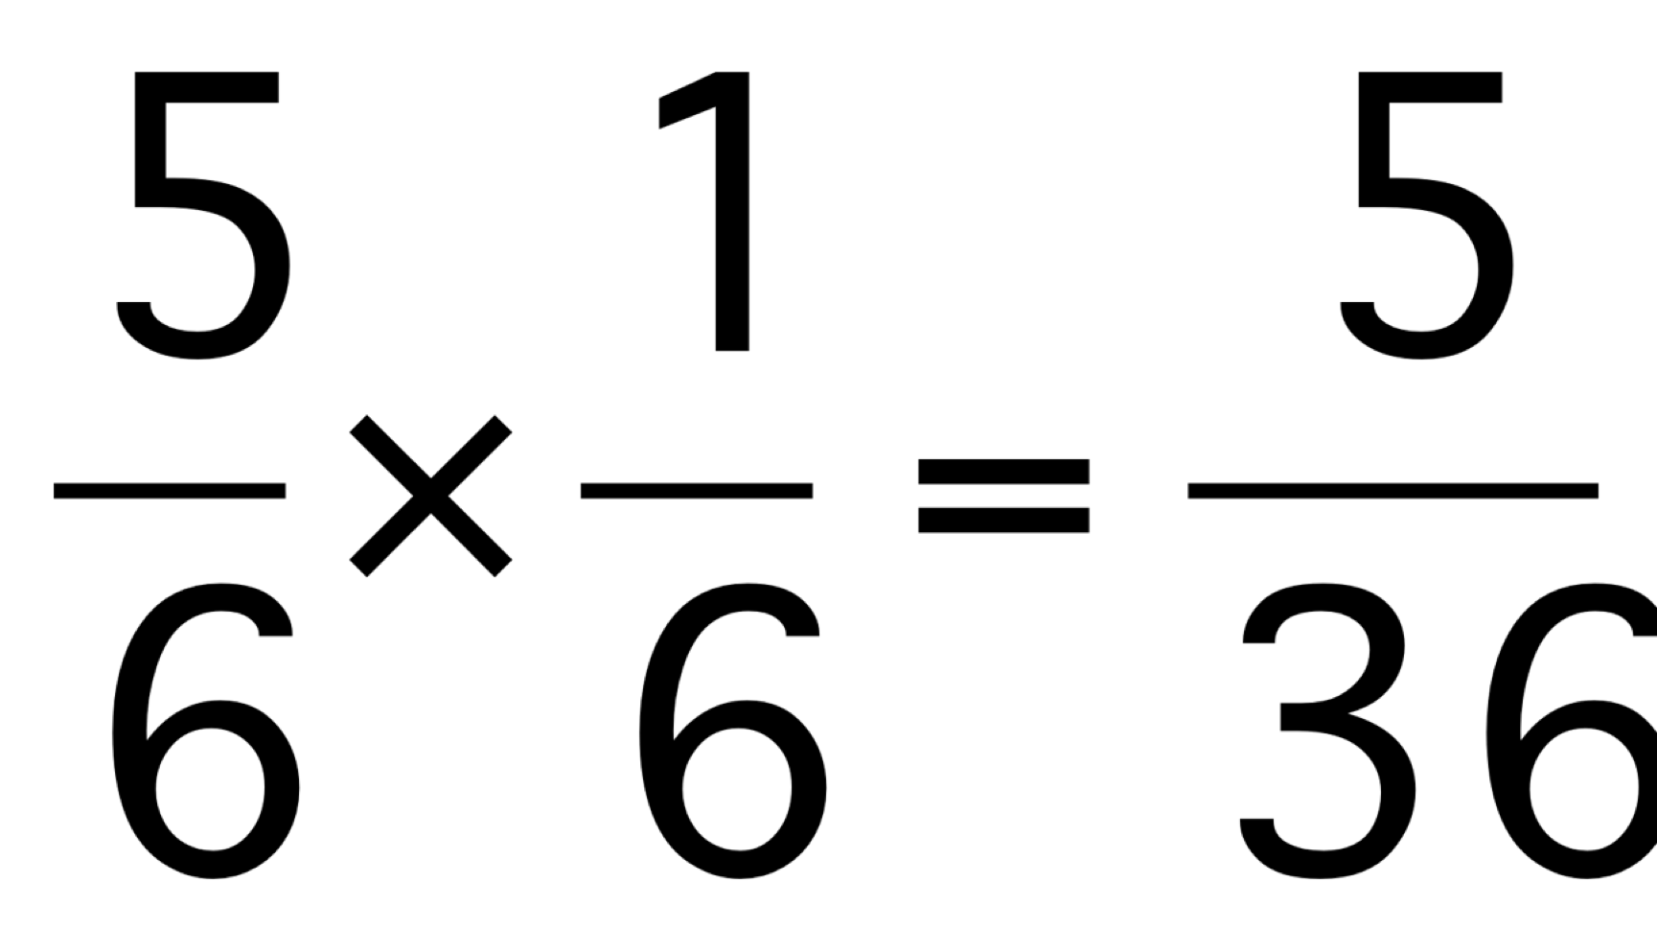
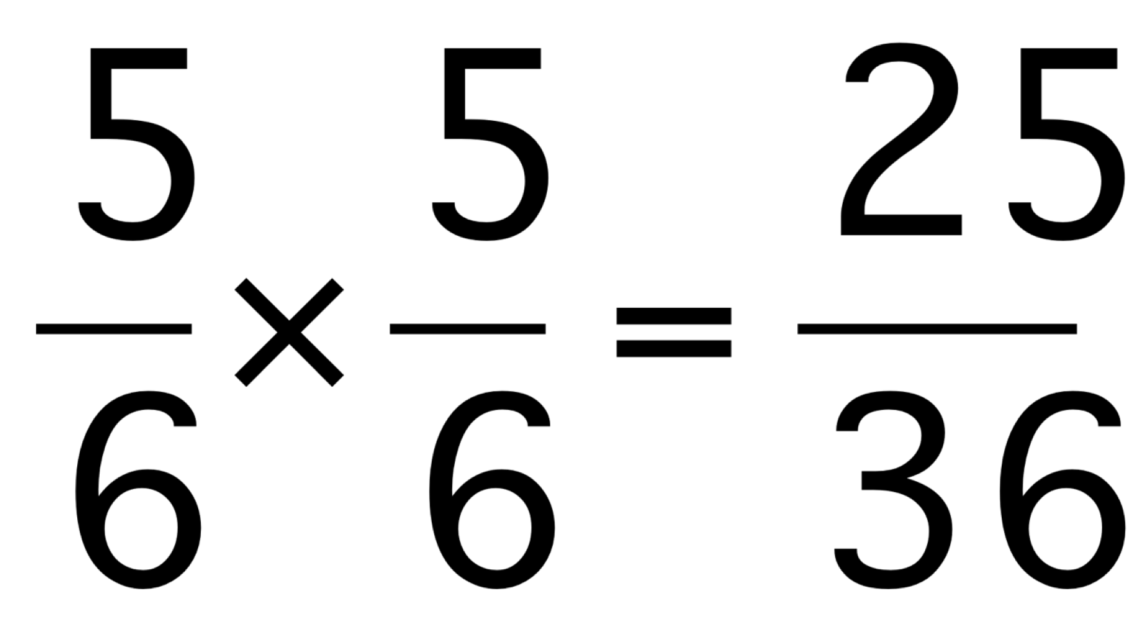
PROBABILITIES
First dice
Second dice
Six
Six
Not six
Six
Not Six
Not six

Slide 12
The probability that Colin is late for work, on any given day = 0.2

Slide 13
First day
Second day
Late
Late
Not late
Late
Not late
Not late

Slide 14
PROBABILITIES
First day
Second day
Late
0.2
0.2
Late
0.8
Not late
0.2
Late
0.8
Not late
0.8
Not late

Slide 15
PROBABILITIES
First day
Second day
Late
0.2 x 0.2 = 0.04
0.2
0.2
Late
0.8
Not late
0.2 x 0.8 = 0.16
0.2
Late
0.8 x 0.2 = 0.16
0.8
Not late
0.8
Not late
0.8 x 0.8 = 0.64

Slide 16

Make up a story of your own
Draw a tree diagram
Label all possible outcomes

Slide 17

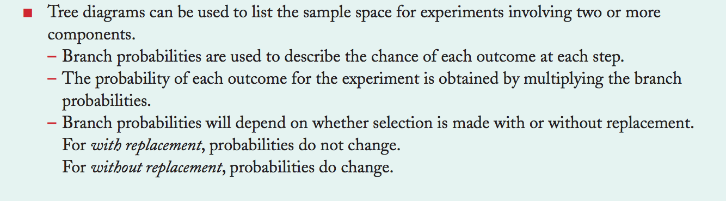
EQ: How do I Draw and use a tree diagram to find conditional probabilities?

Slide 18

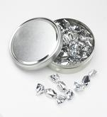
Colin has a tin of sweets:
6 chocolates and 4 mints
Produce a tree diagram to show the probabilities of taking one sweet followed by another sweet.
What is the probability of taking two of the same type?

Slide 19
First sweet
Second sweet
Chocolate
Chocolate
Mint
Chocolate
Mint
Mint

Slide 20

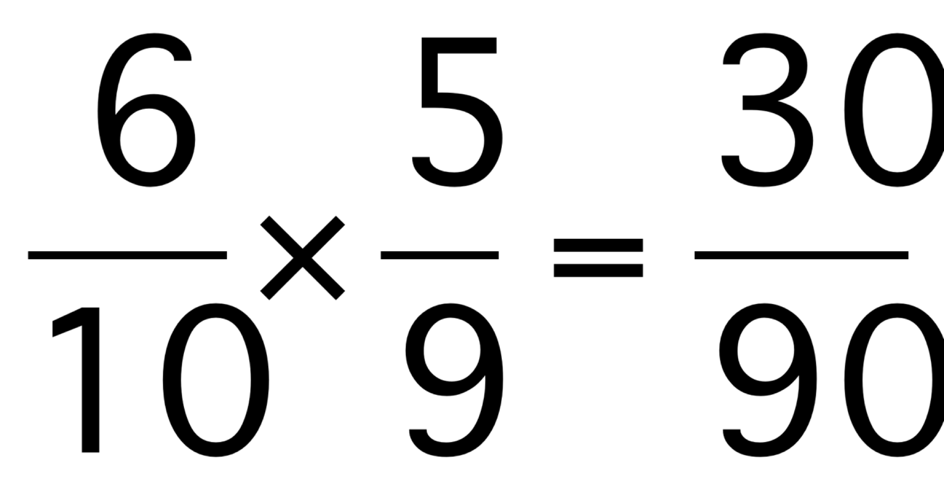
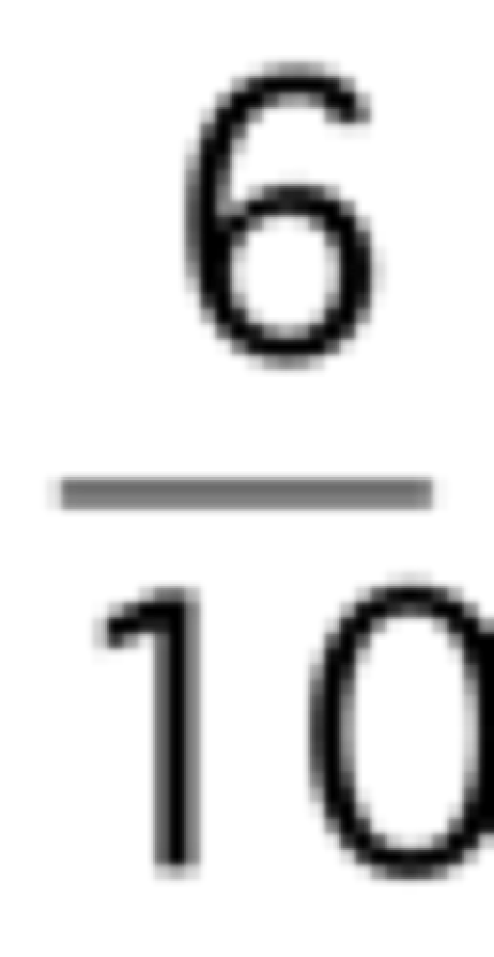

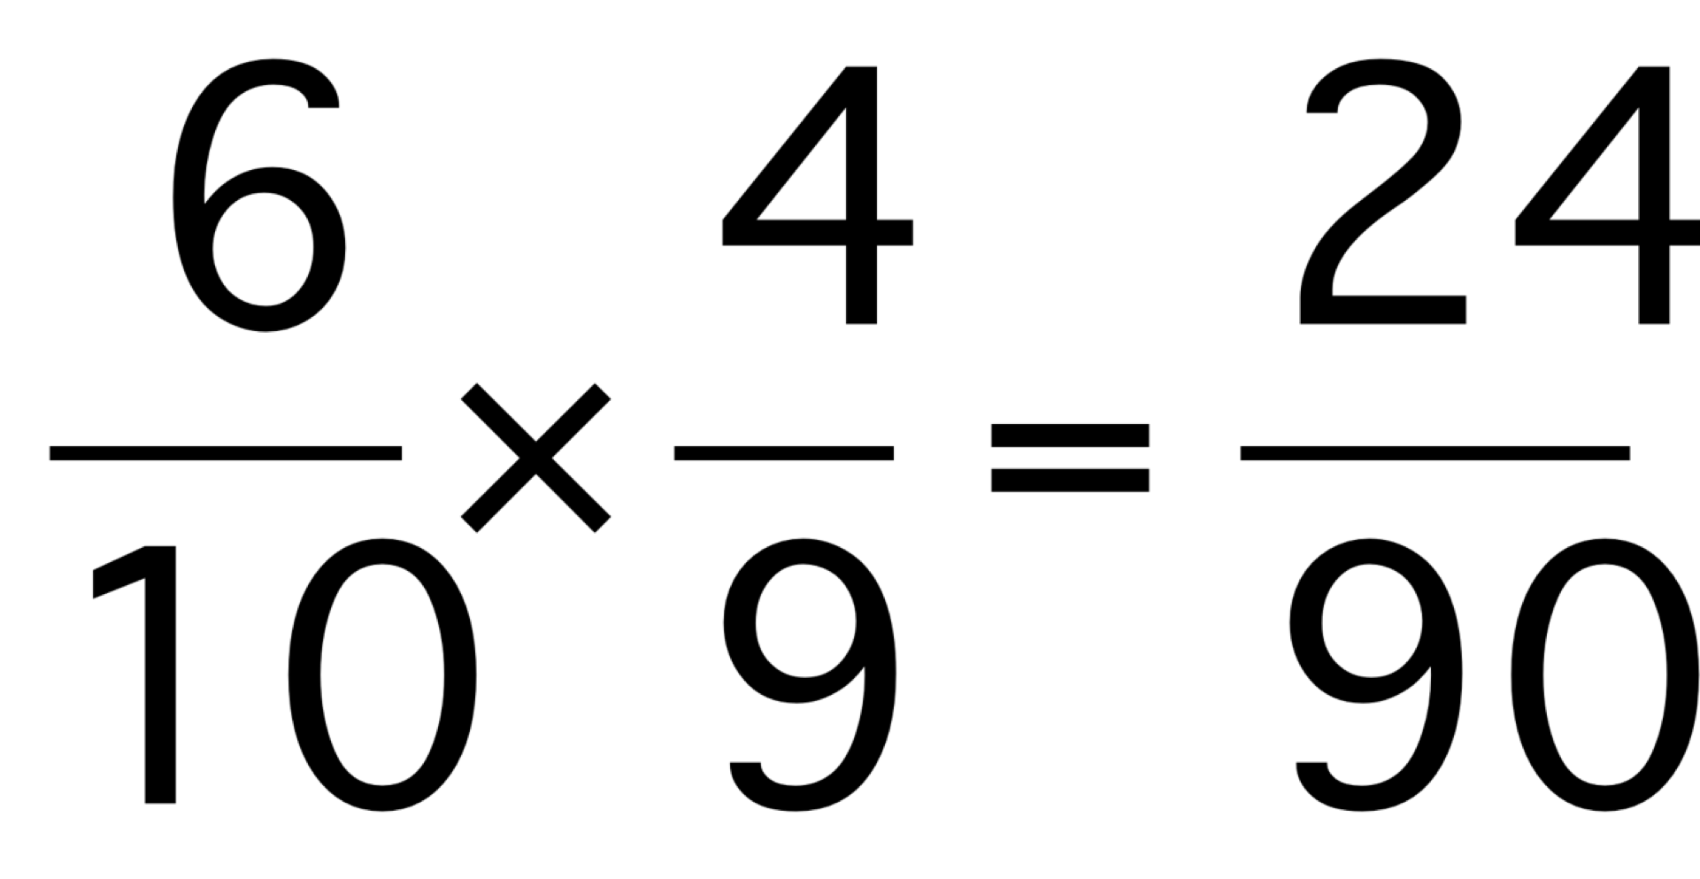
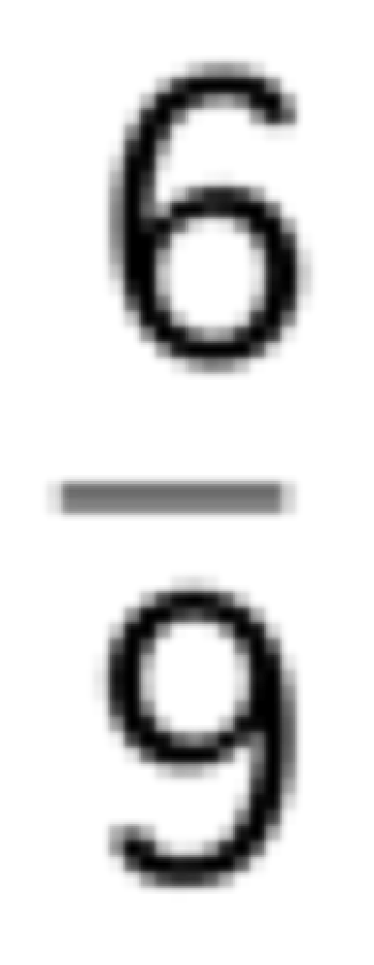
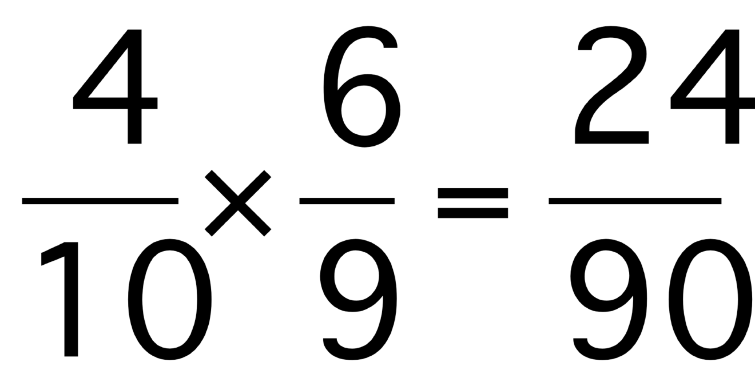
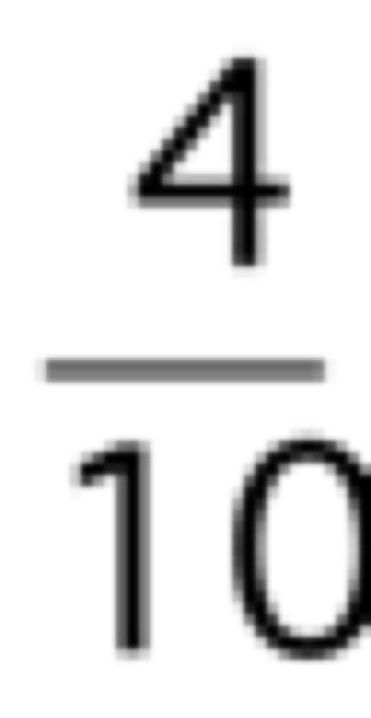
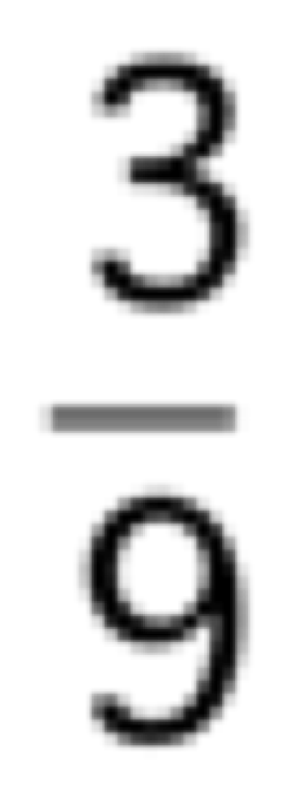
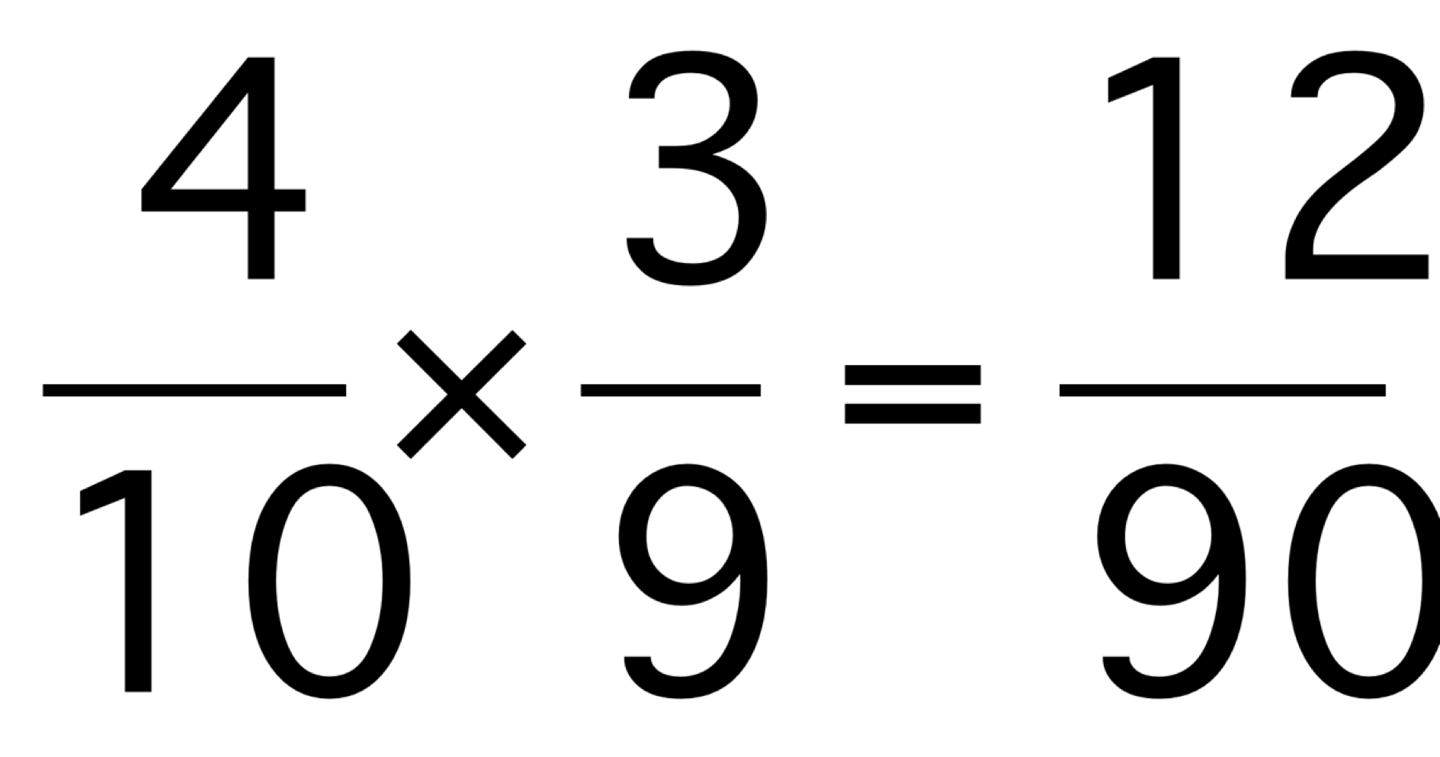
PROBABILITIES
First sweet
Second sweet
C
C
M
C
M
M

Slide 21
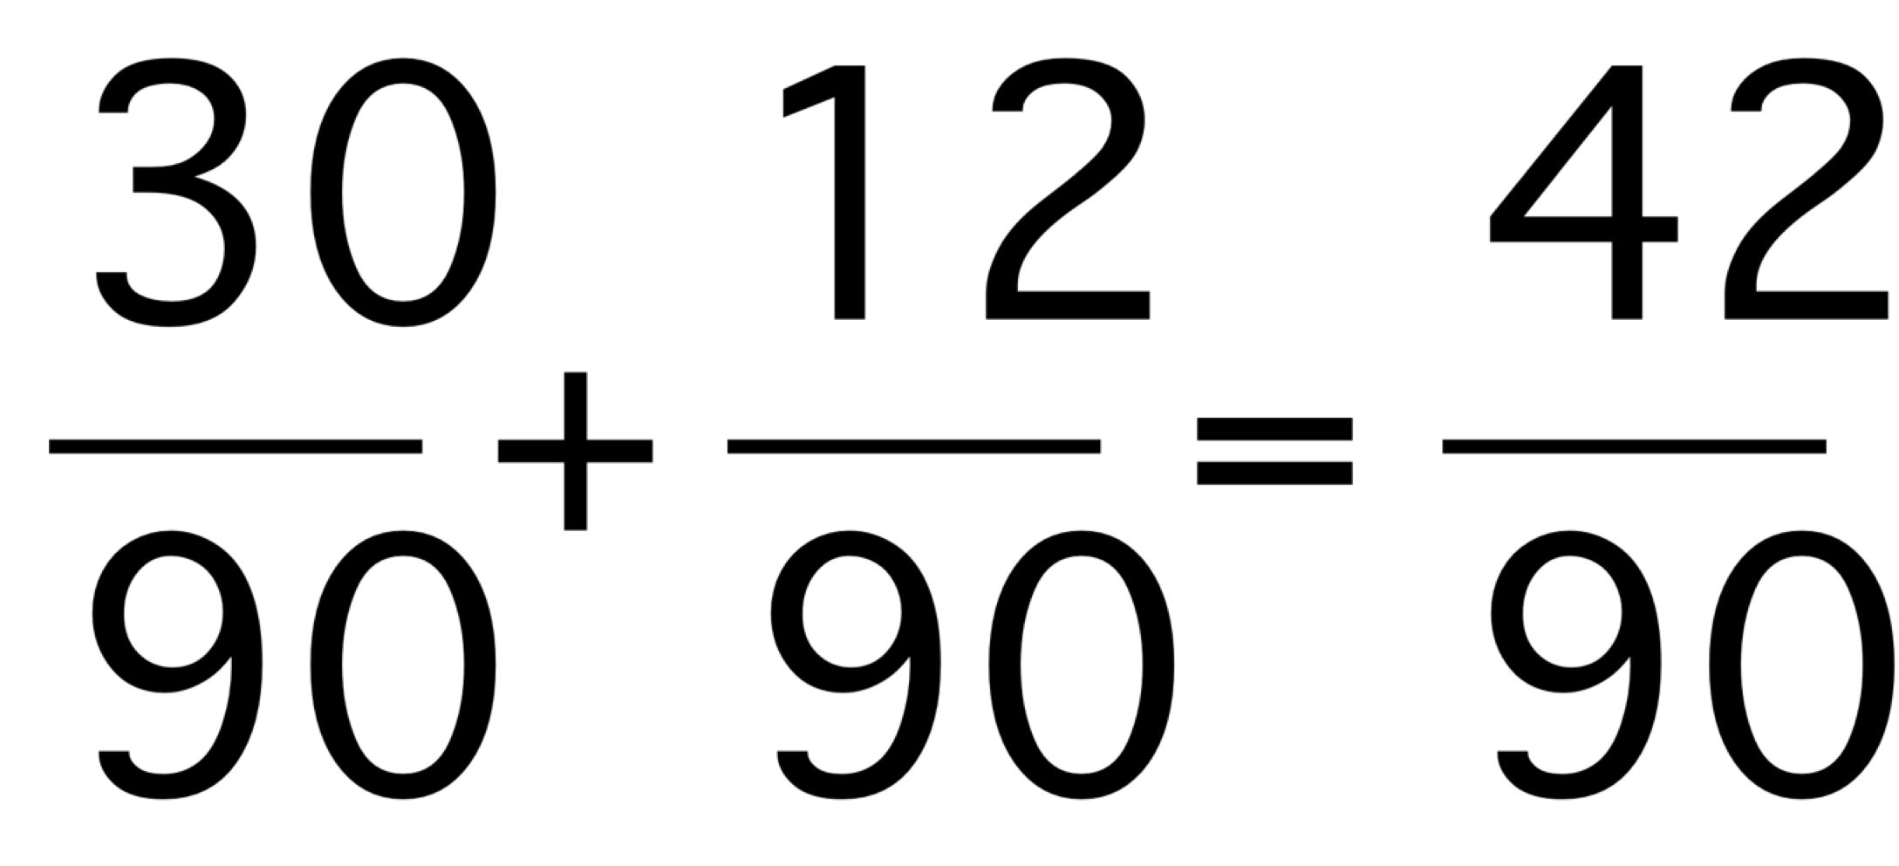
What is the probability of taking two of the same type?
Chocolate and chocolate =
Mint and mint =
So two of the same =

Slide 22

Probability using Tree Diagrams Work Package

